Slide 2
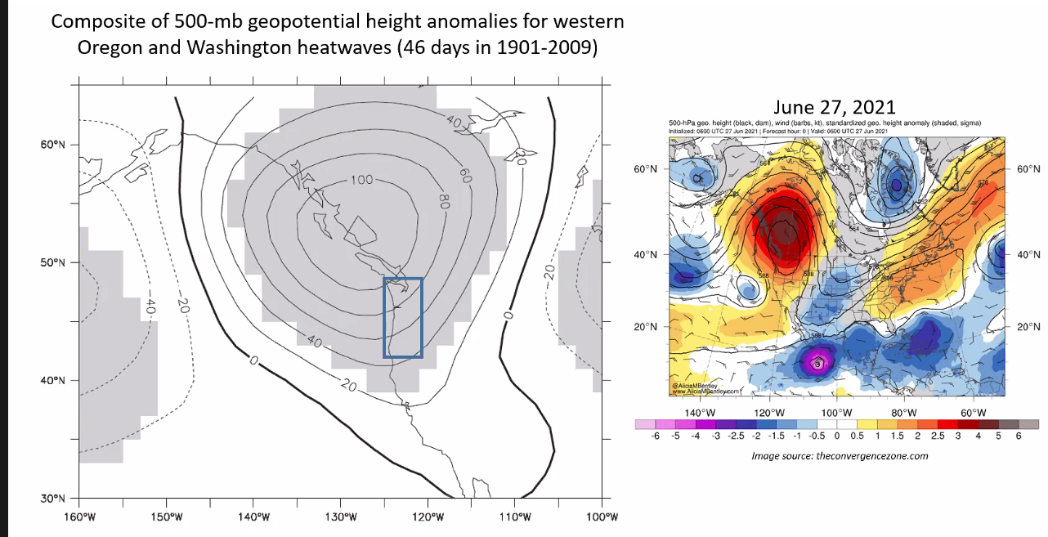

Slide 3
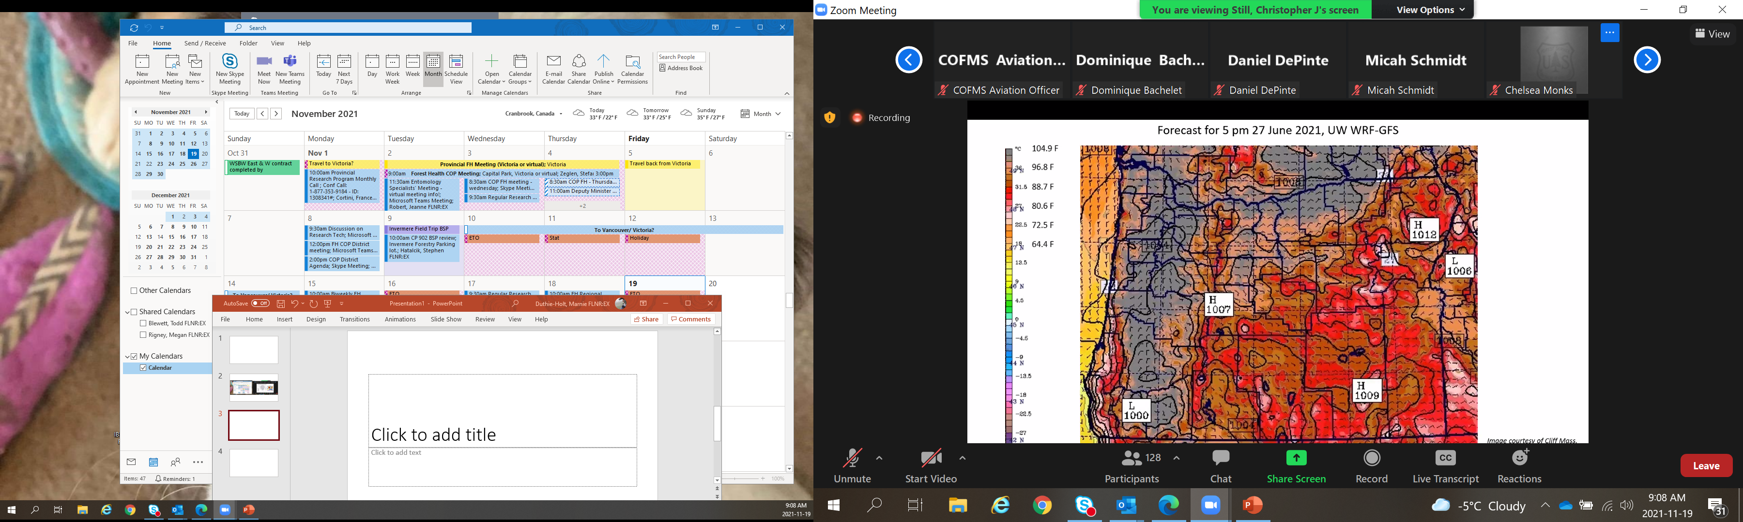

Slide 4
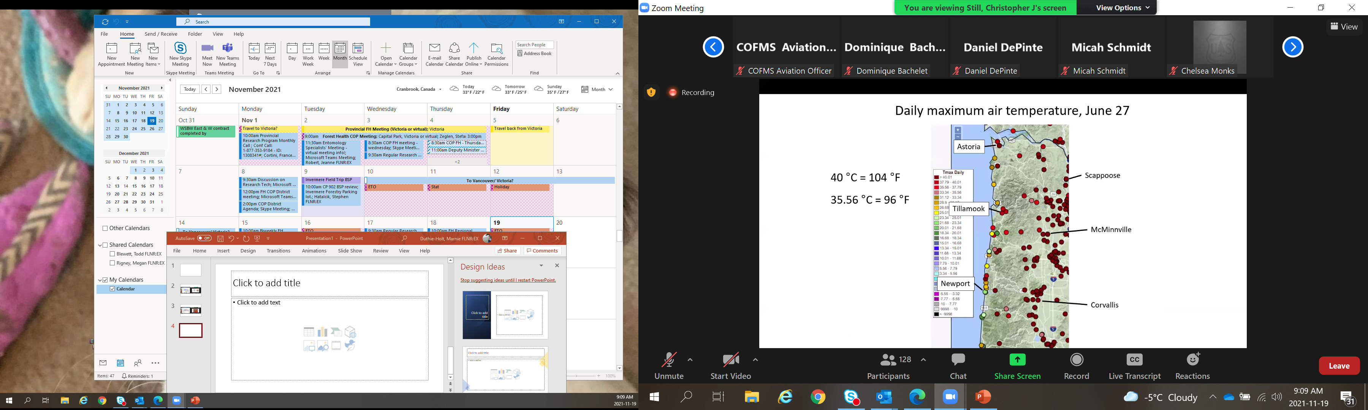

Slide 10
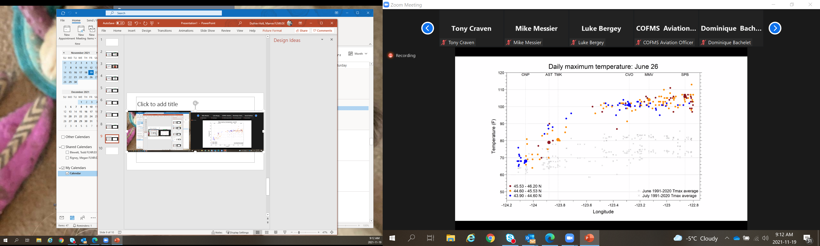

Slide 11
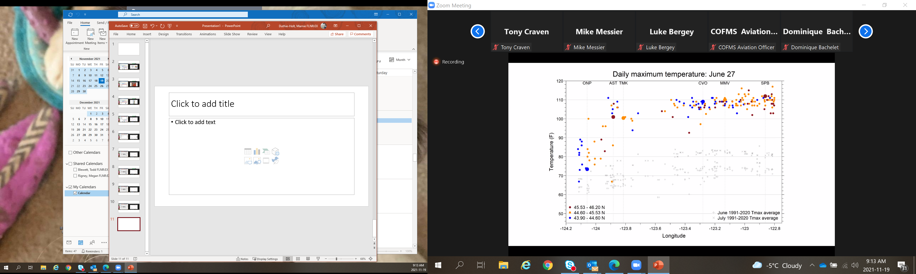

Slide 12
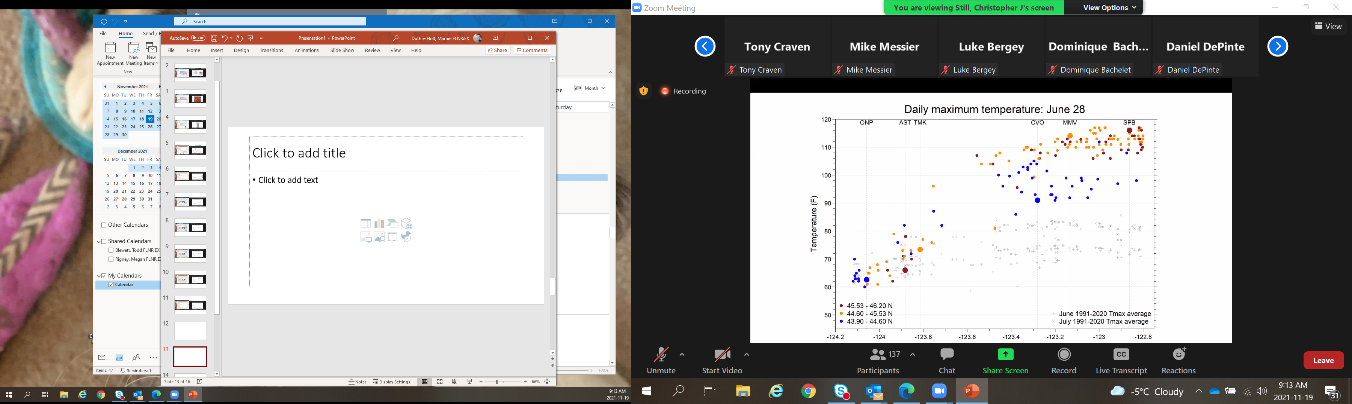

Slide 13
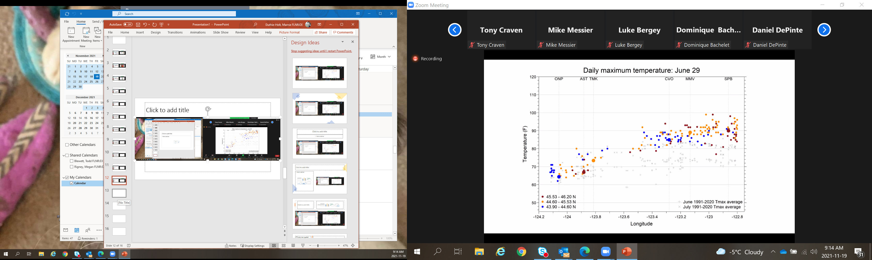

Slide 14
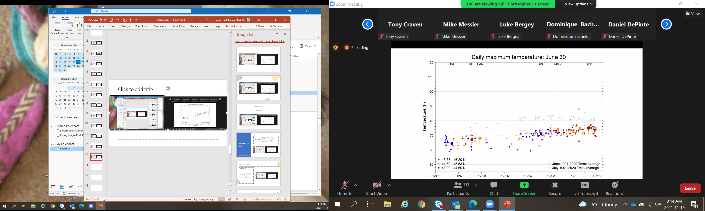

Slide 15
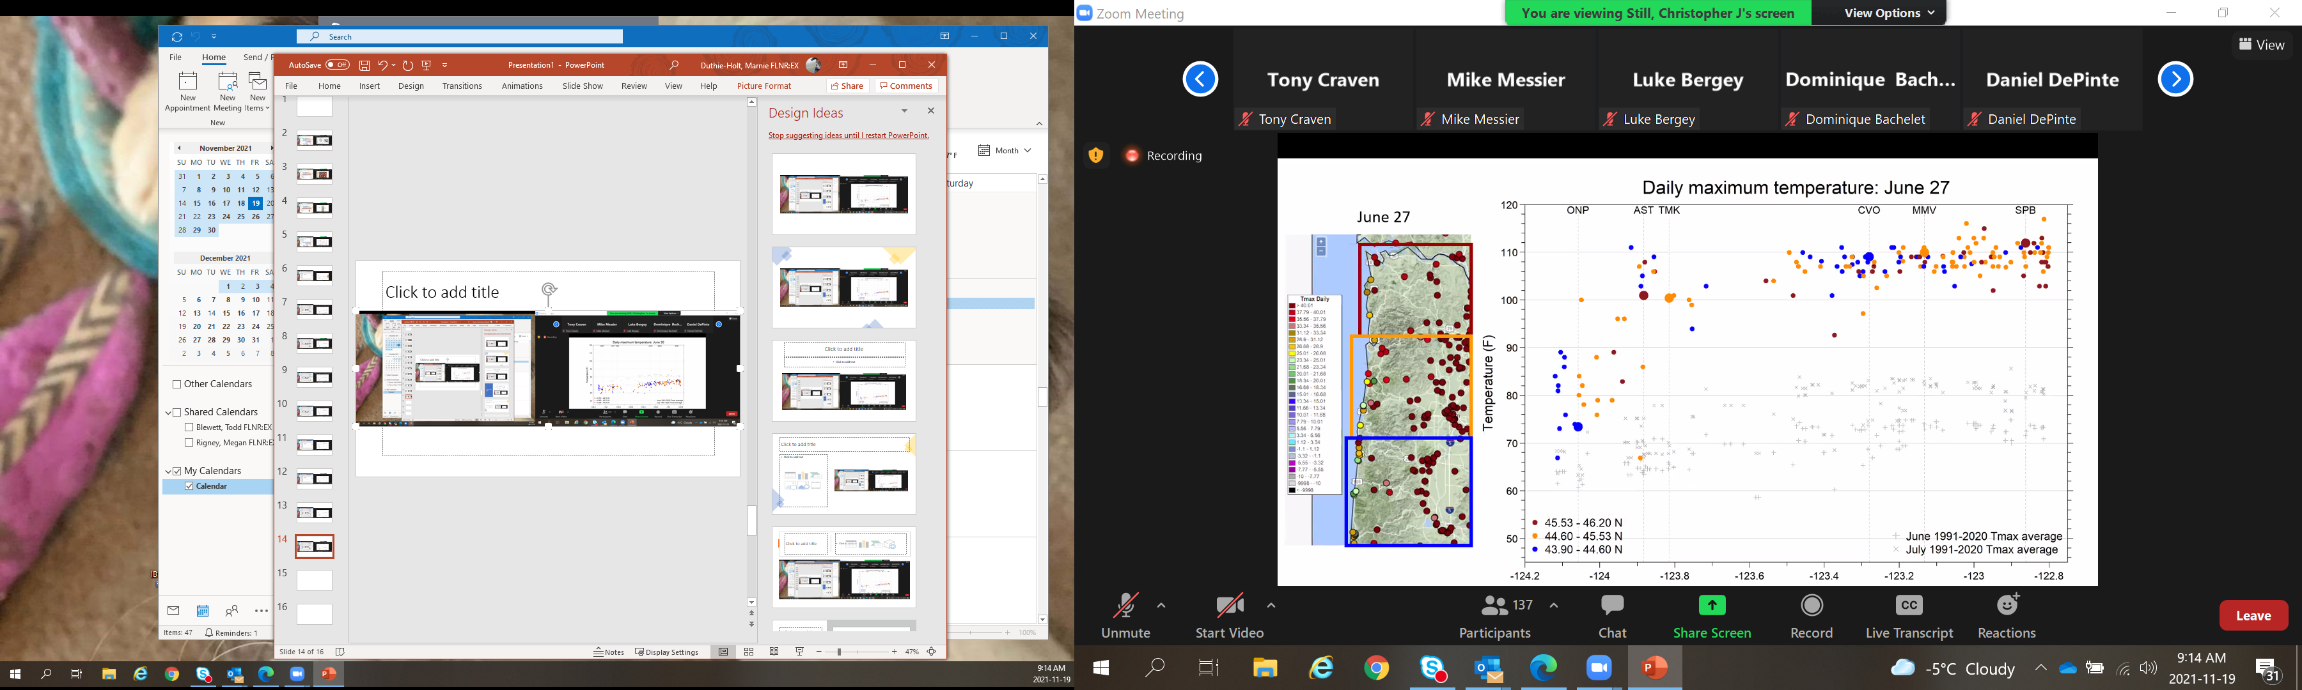

Slide 16
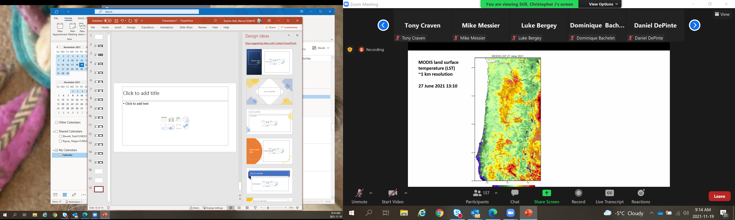

Slide 17
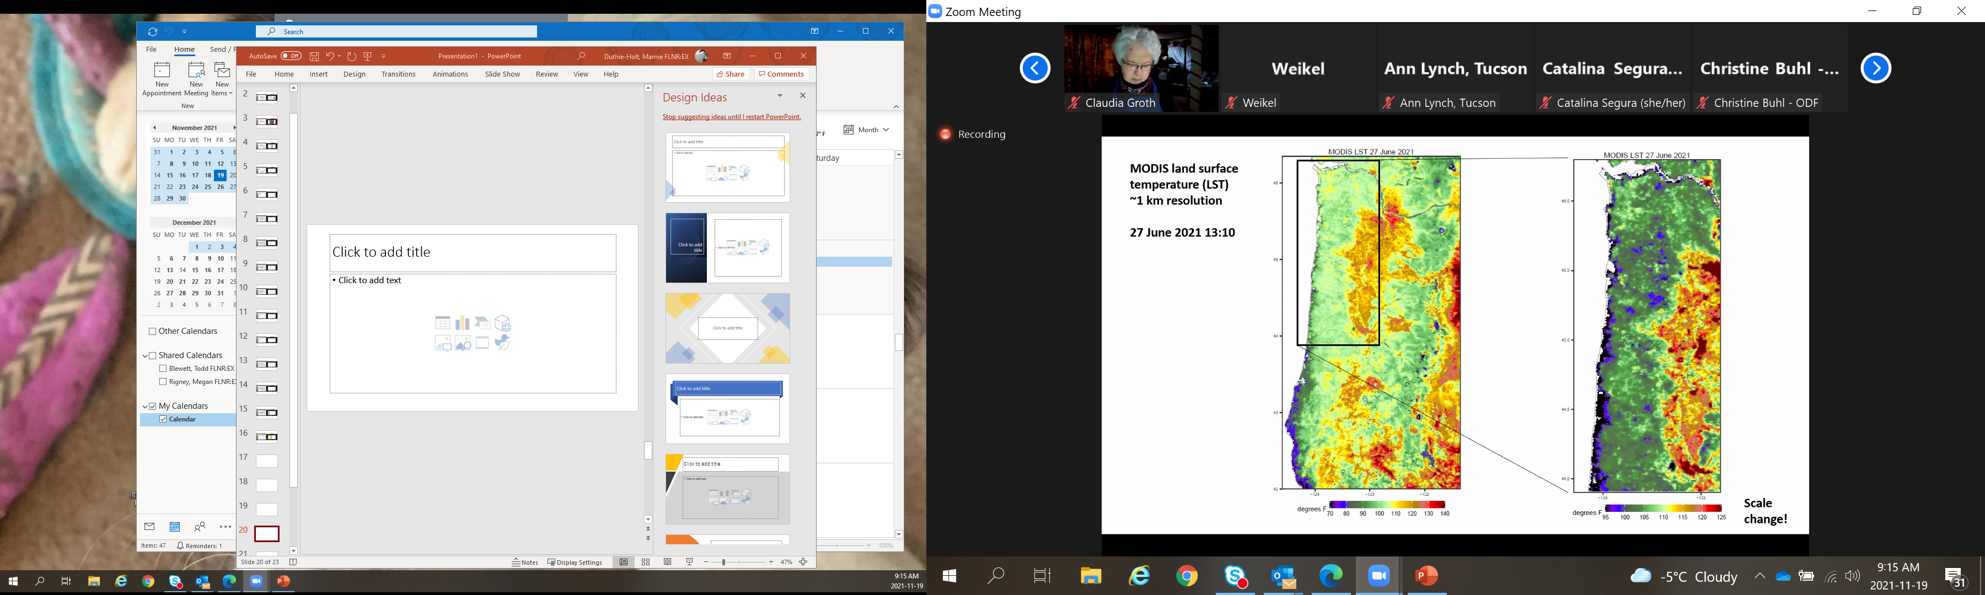

Slide 18
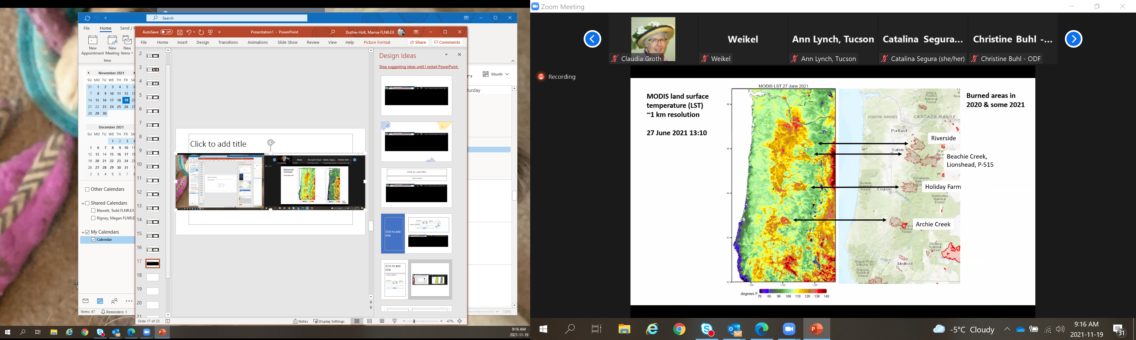

Slide 19
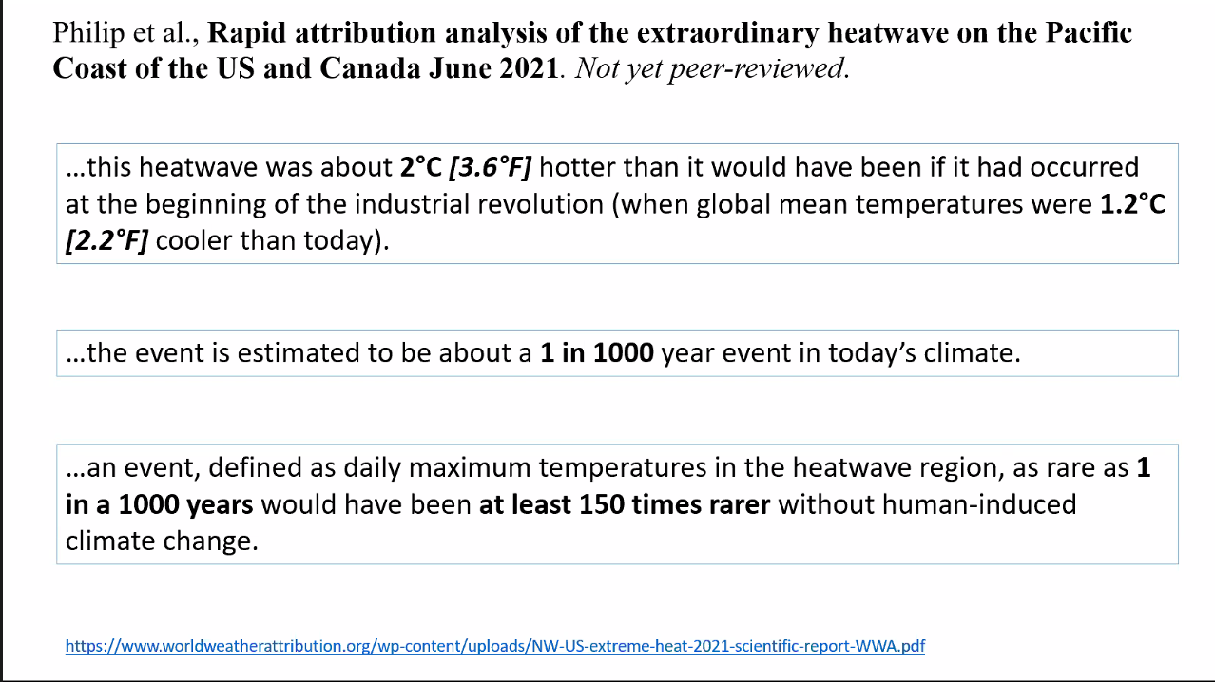

Slide 20
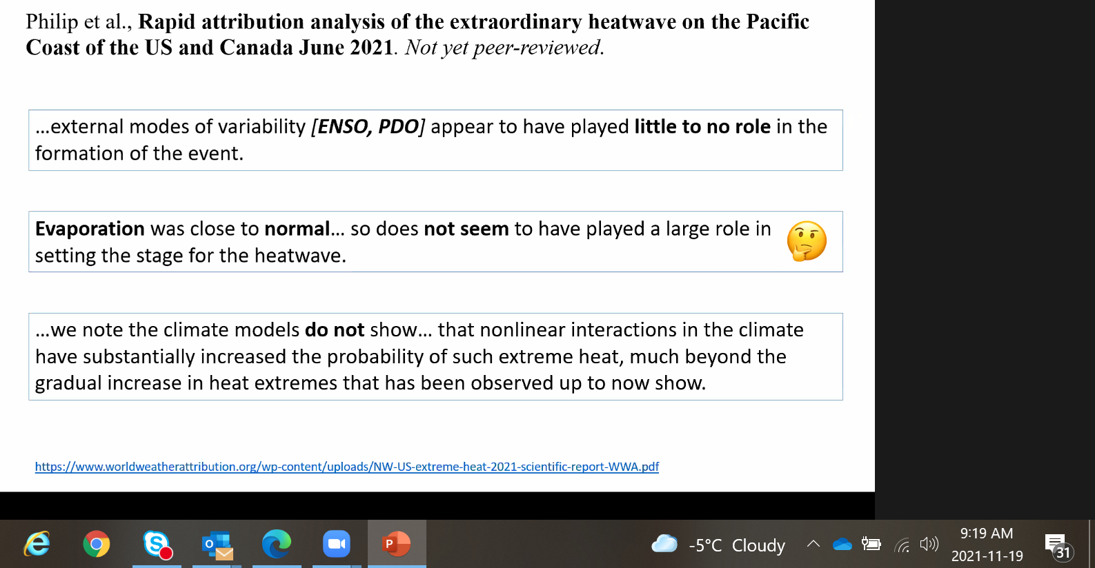

Slide 21
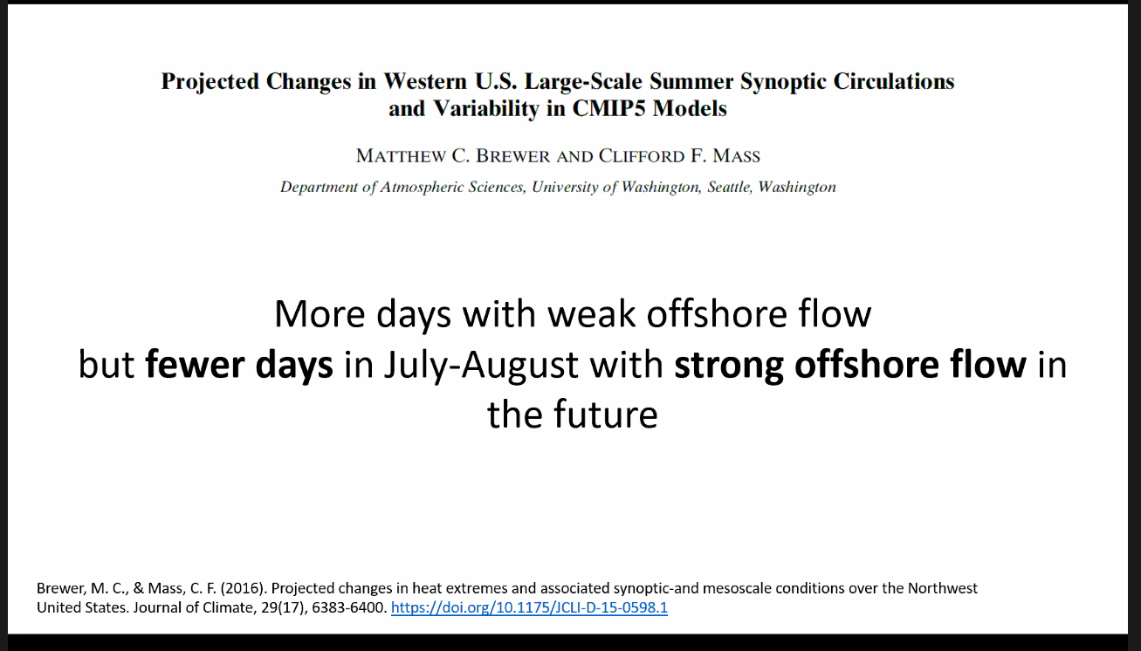

Slide 22
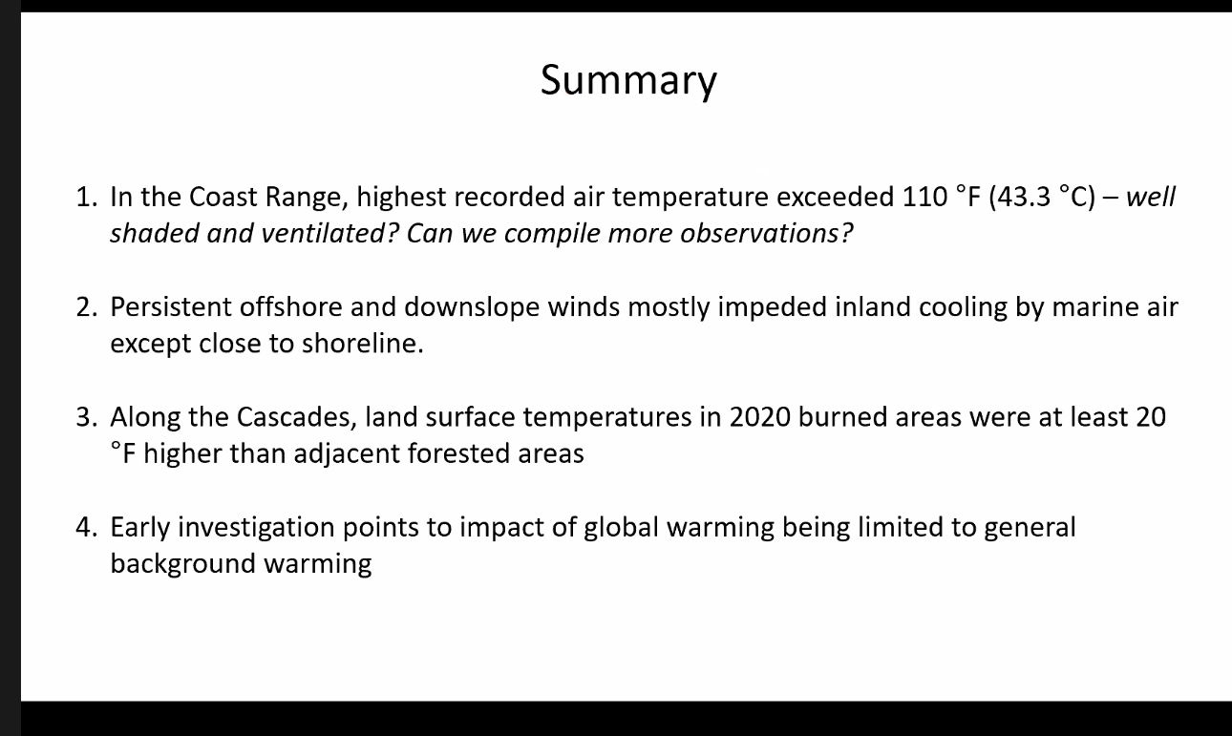

Slide 23
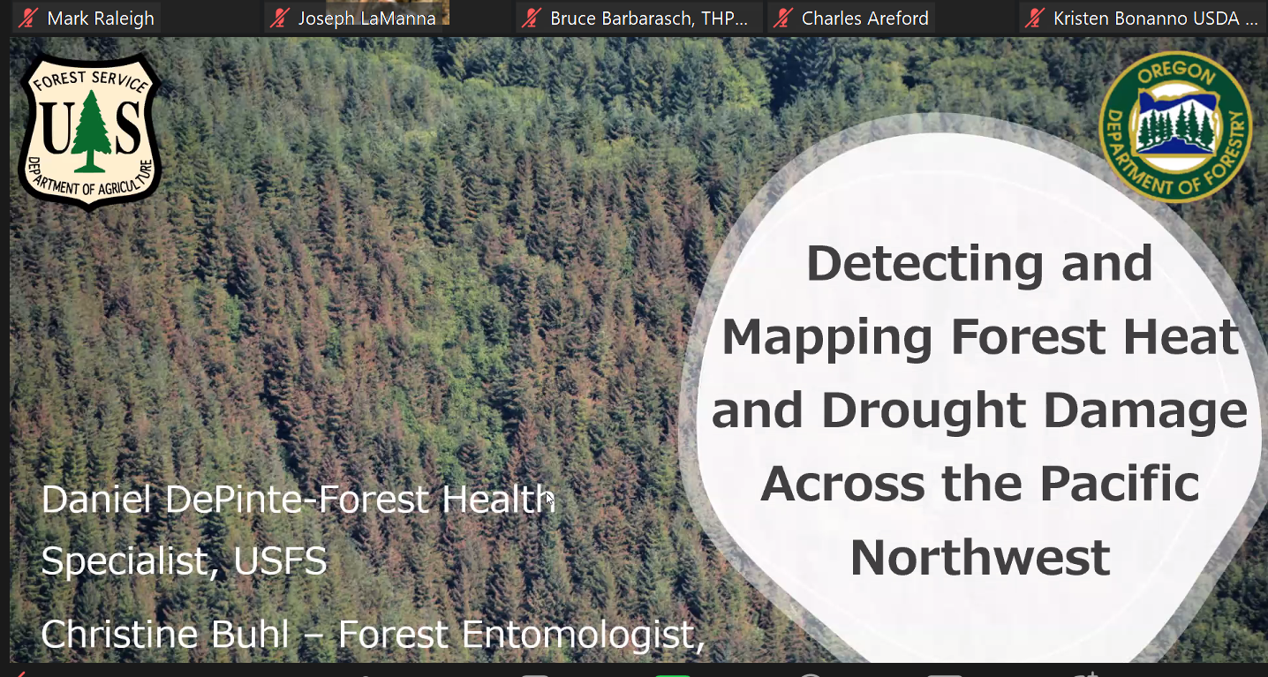

Slide 24
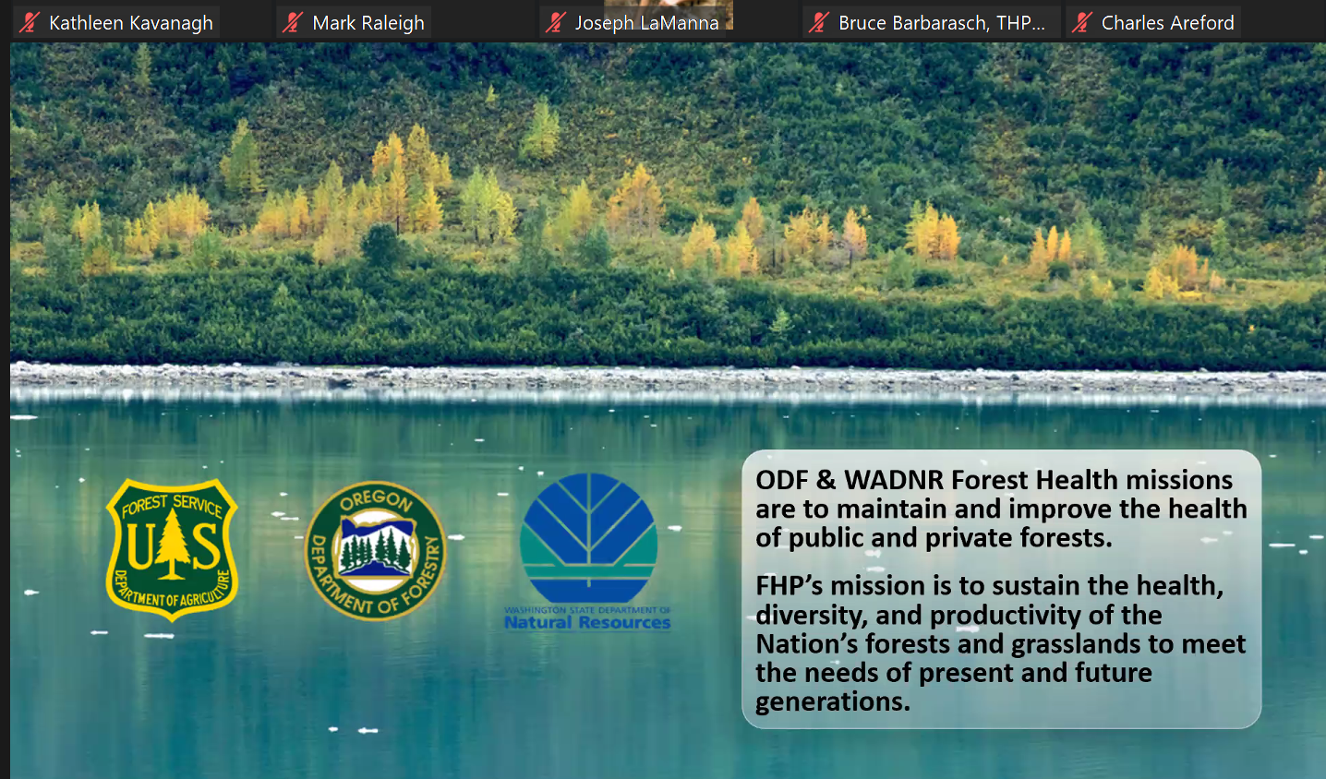

Slide 25
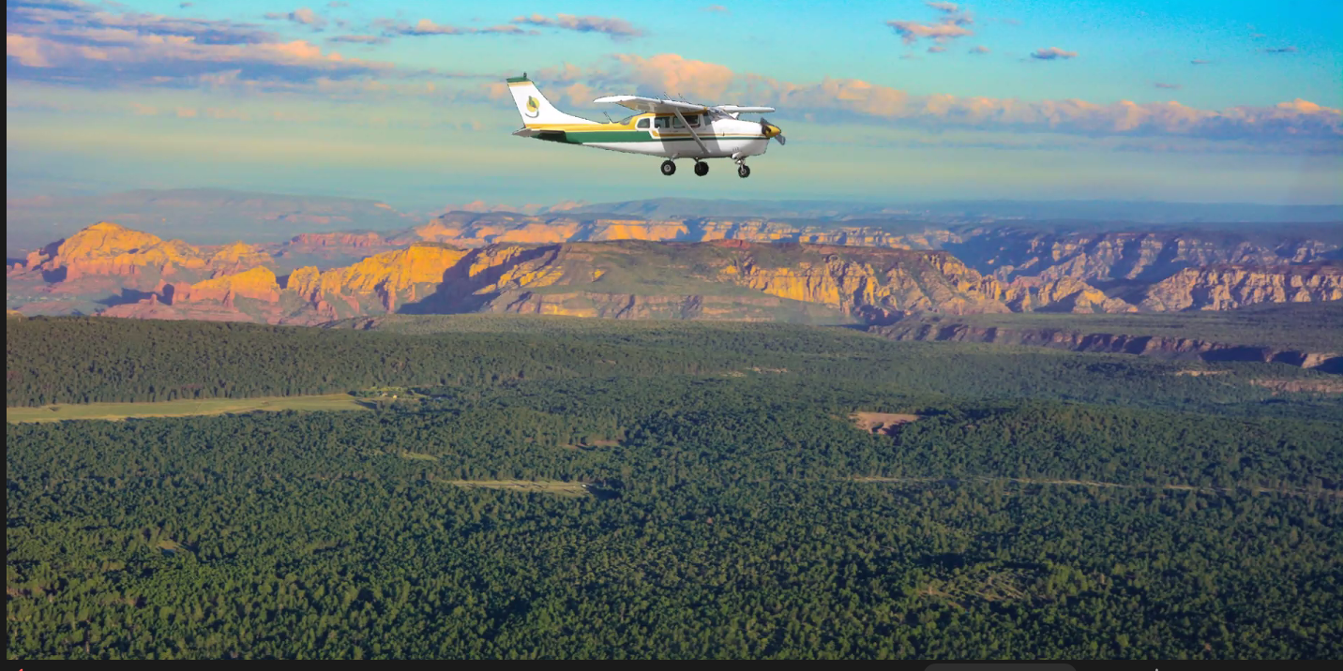
90% fixed wing with tablets, app devoped

Slide 26
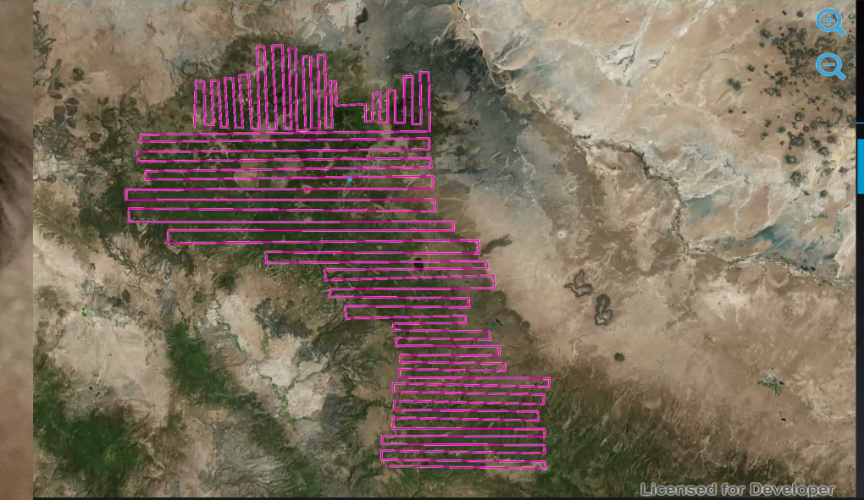

Slide 27
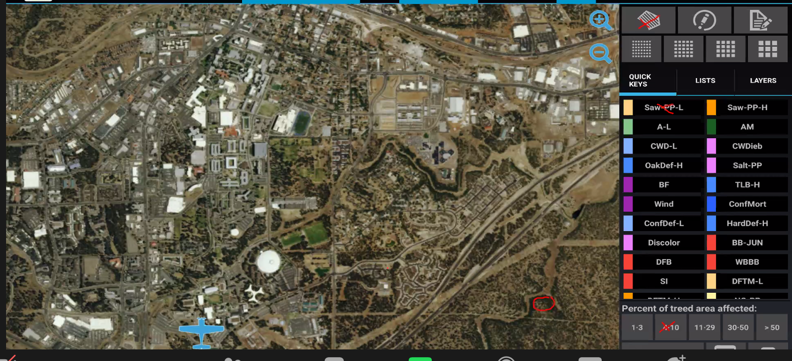

Slide 28
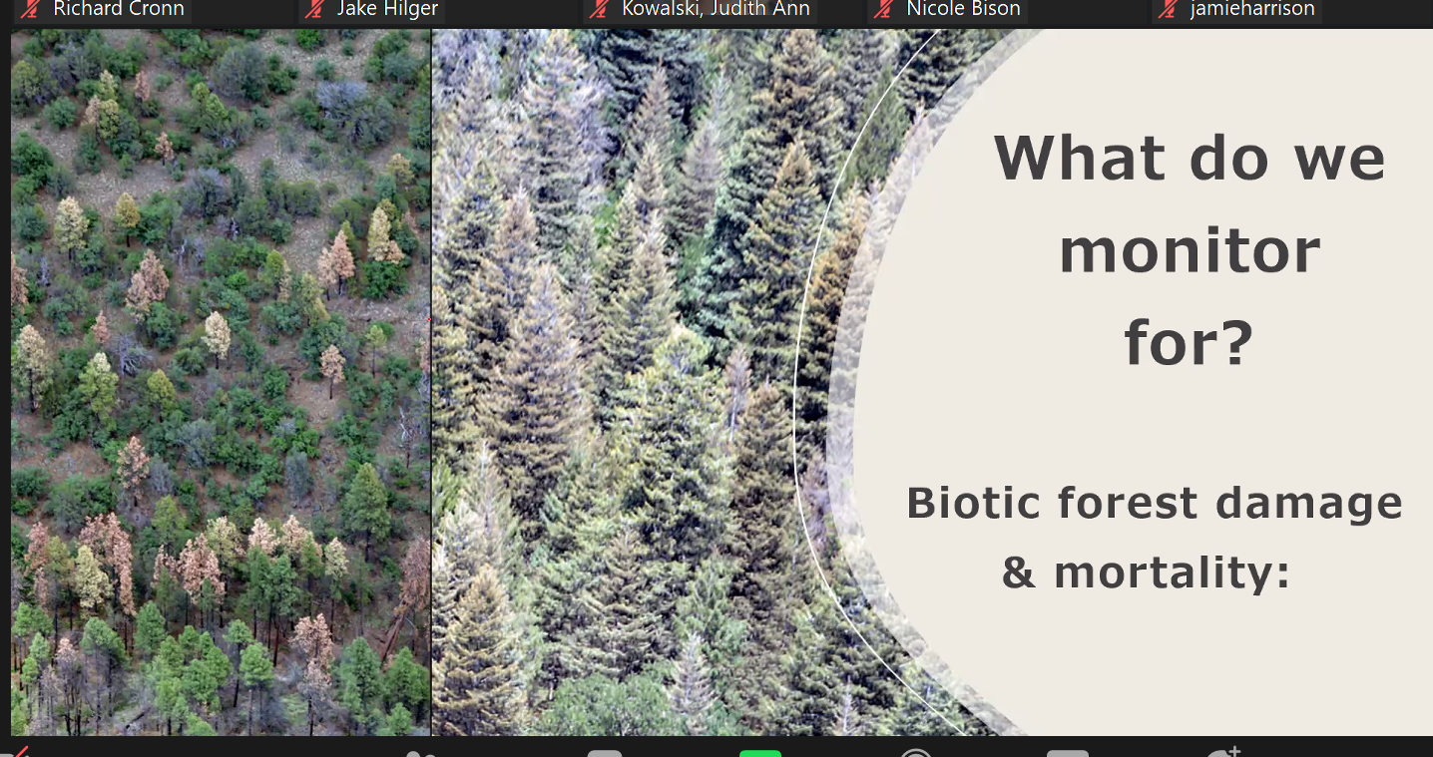

Slide 29
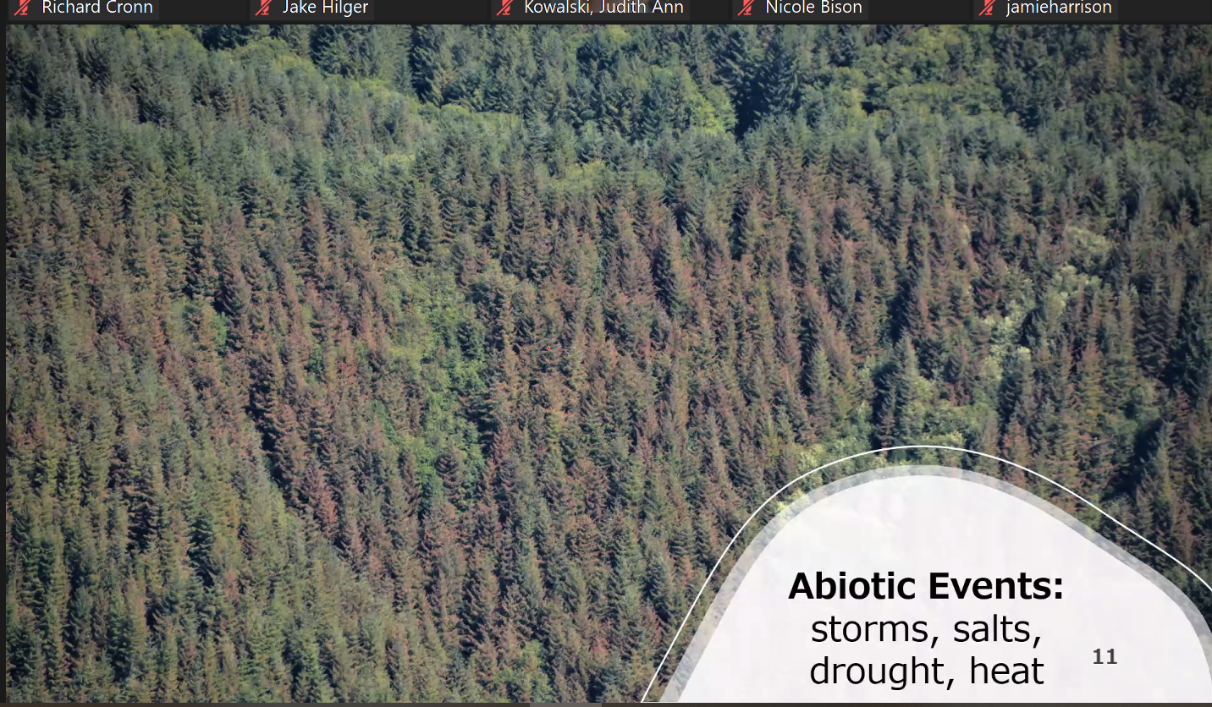

Slide 30
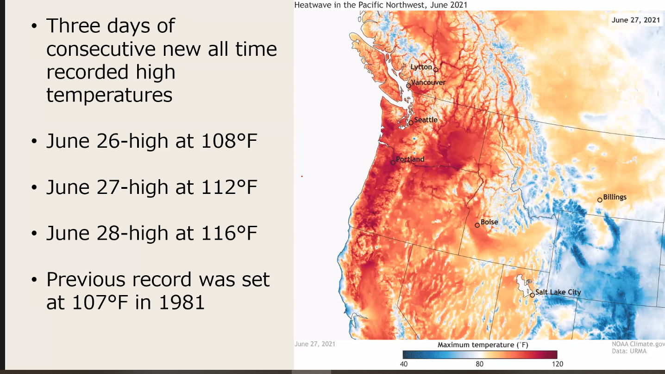

Slide 31
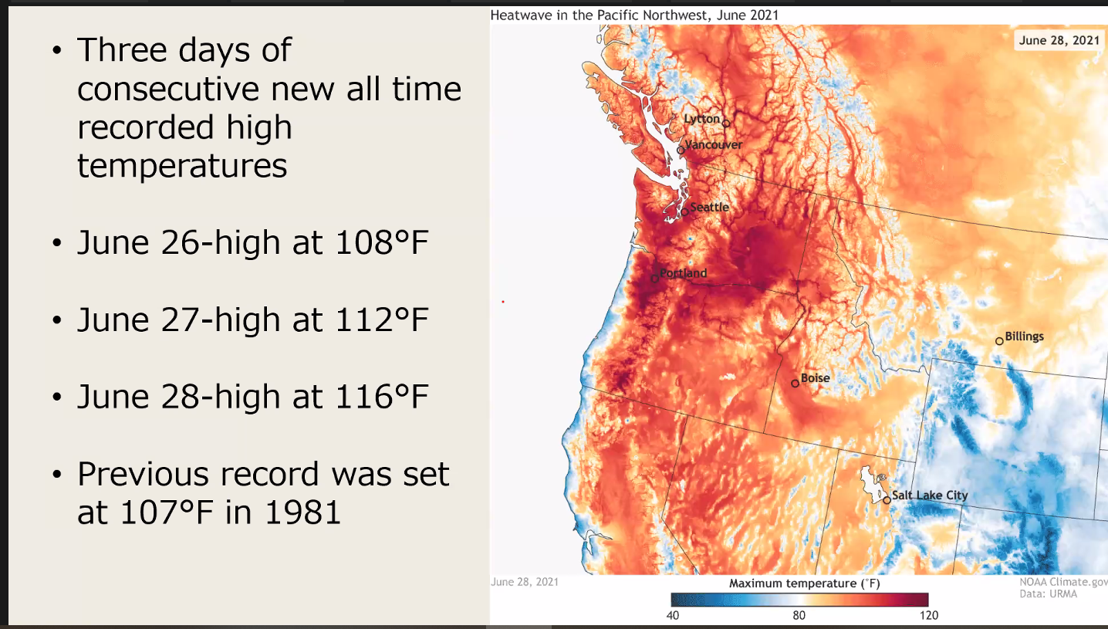

Slide 32
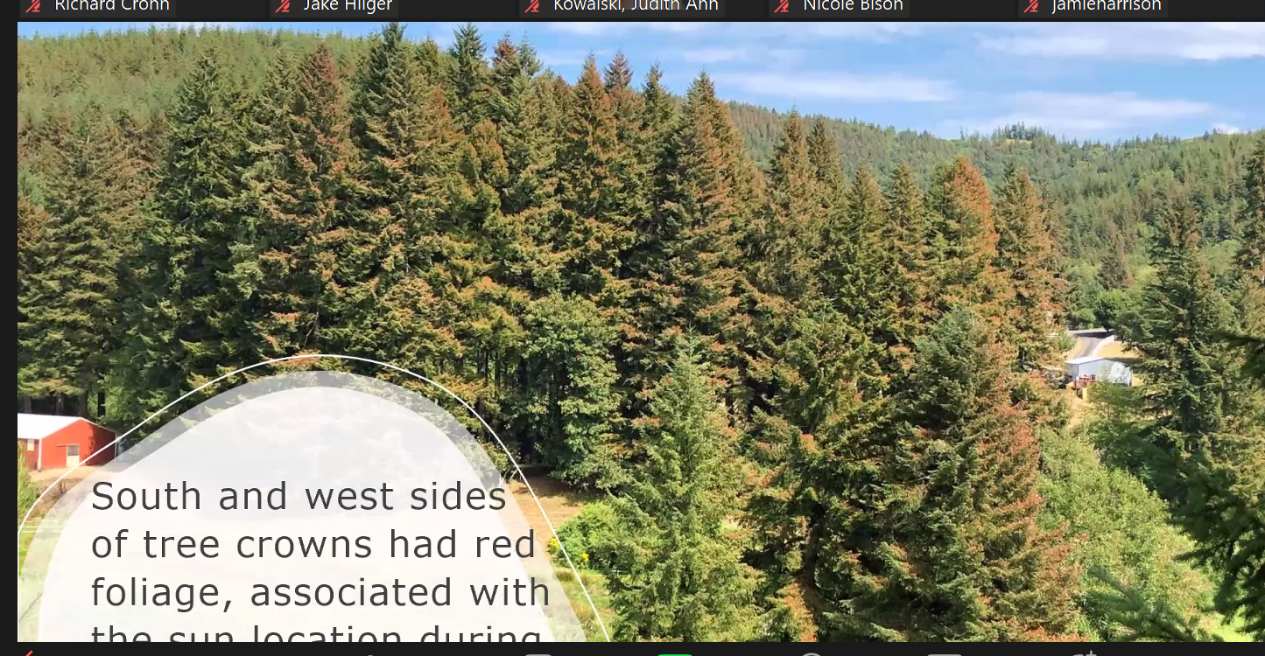

Slide 33
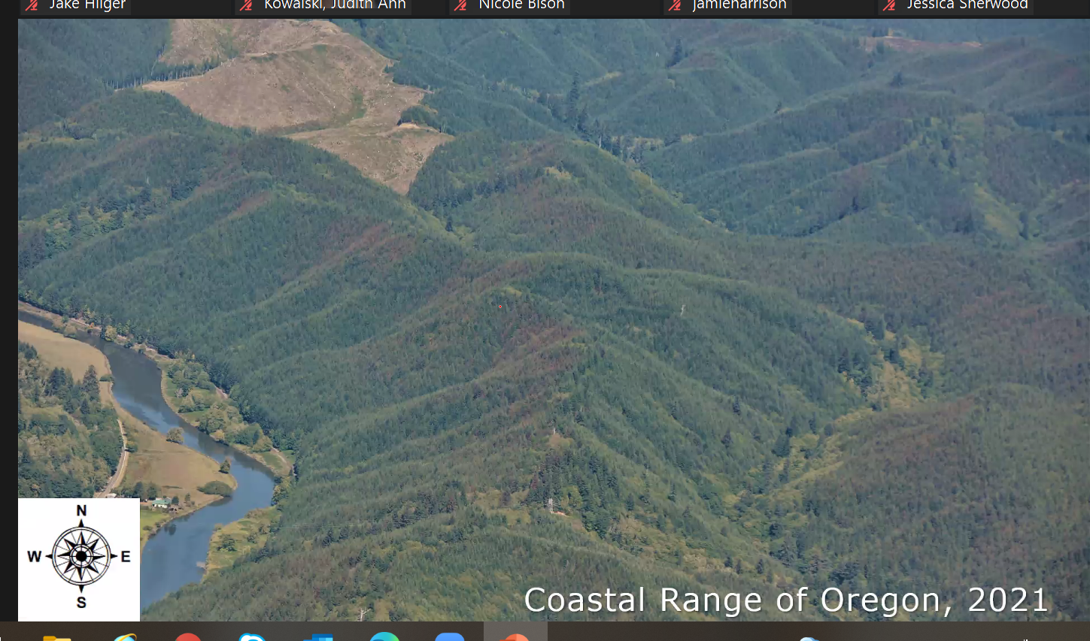

Slide 34
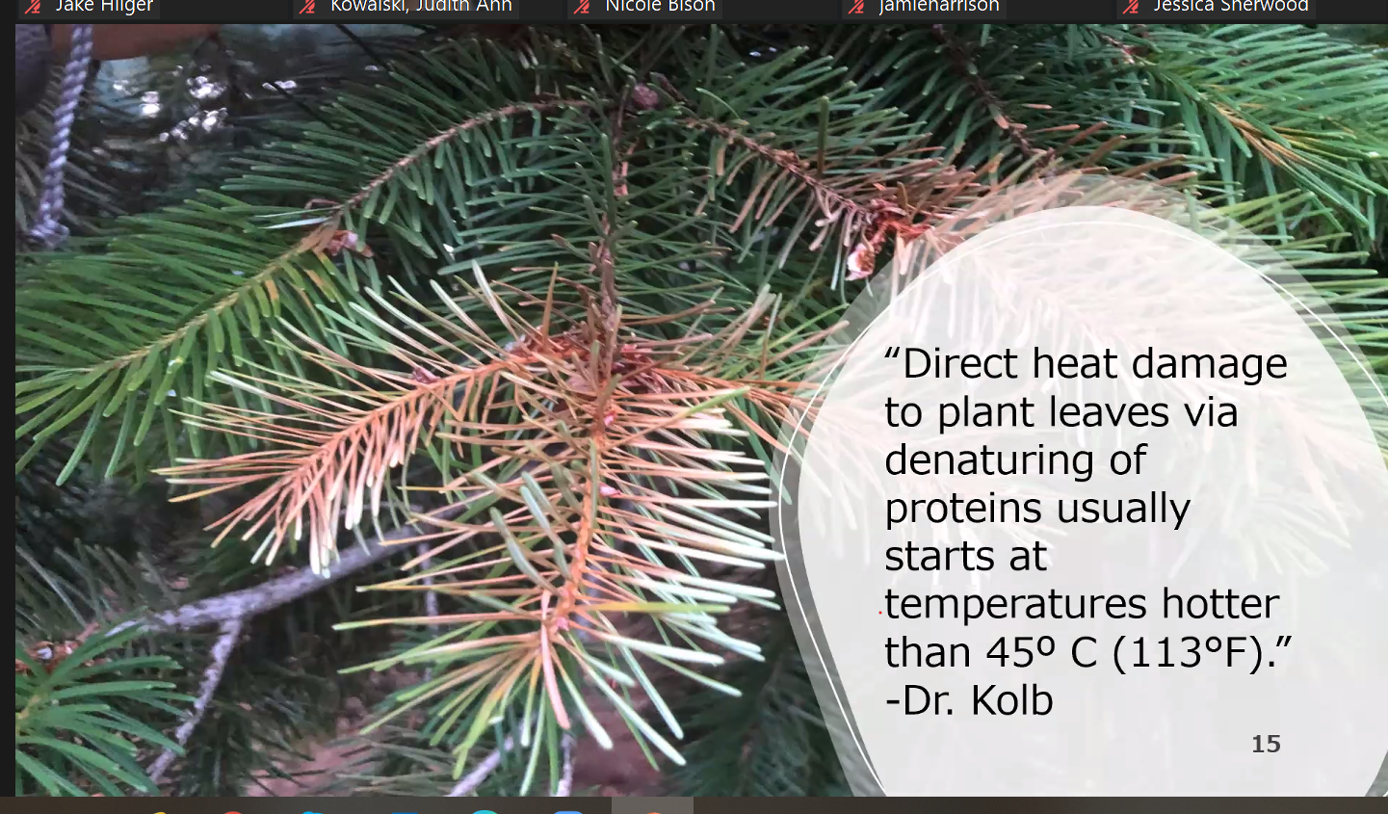
New soft foliage most damaged
20 degrees hotter dark heat absorabtion

Slide 35
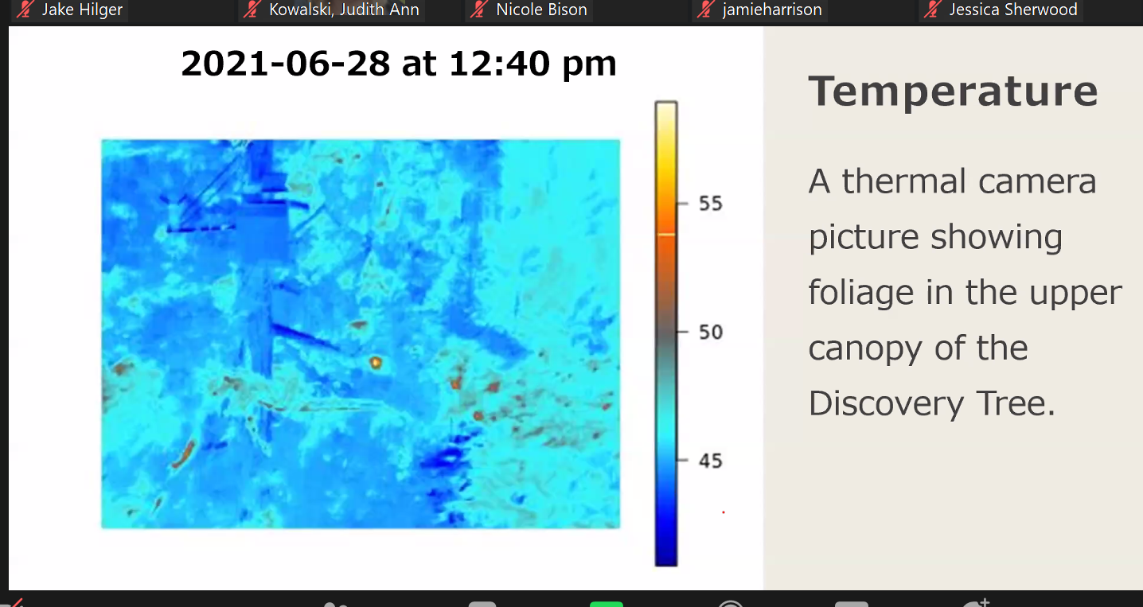

Slide 36
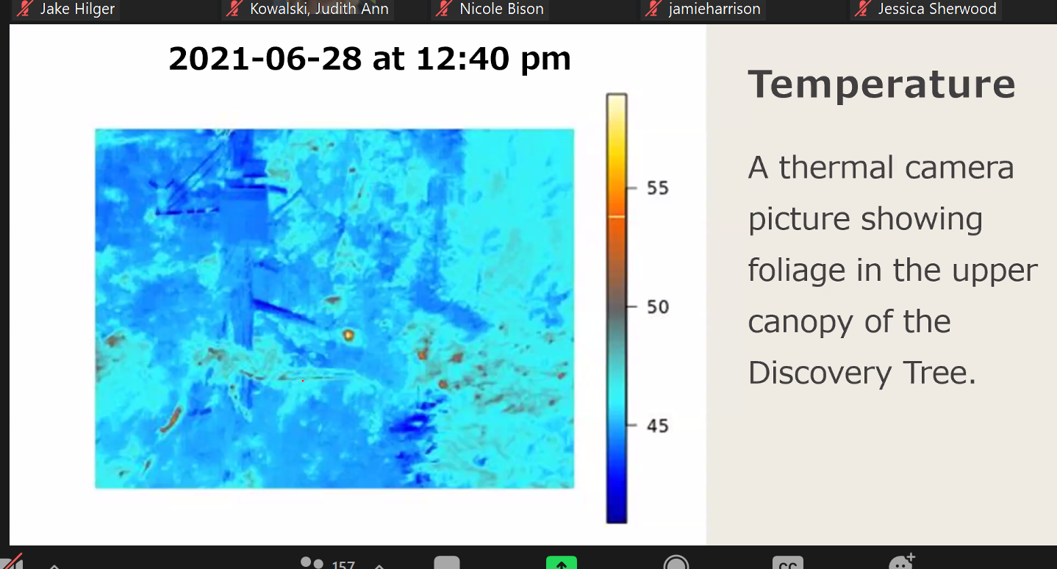
Bark 50 degrees Celsius

Slide 37
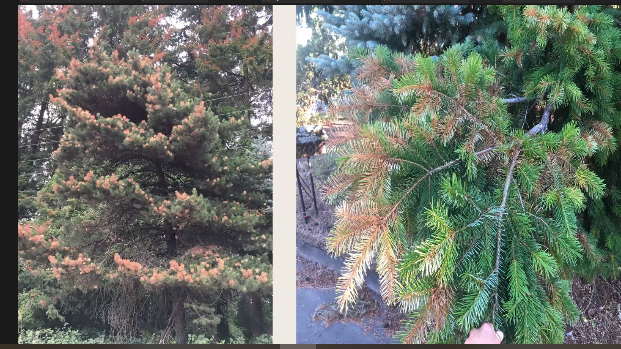
Biotic and abiotic combination
Lethal temperature several hours
Drought would be even distribution ofdmage

Slide 38
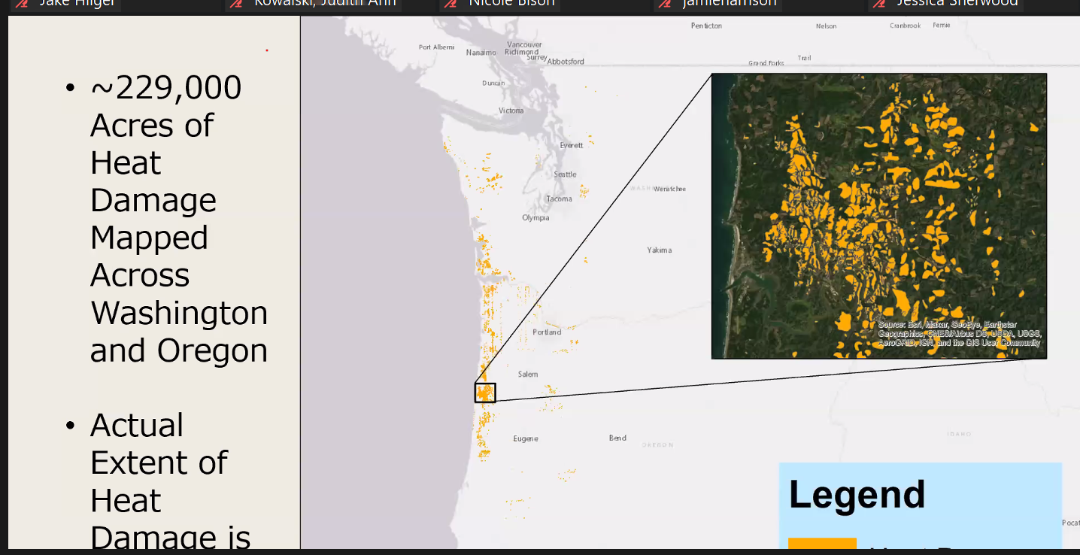
Maping difficult N-S lines hiding outer side, turn around and see across entire landsicape
Started late in year fall came

Slide 39
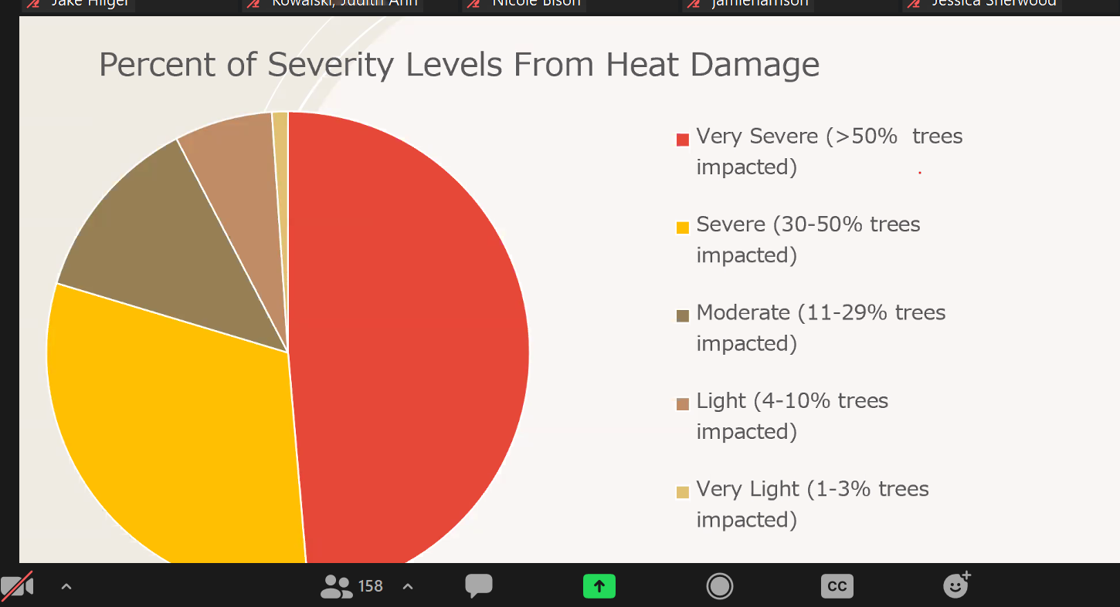
Most in very severe
Host group all species
Hardwoods but fall
Then mapped only conifers

Slide 40
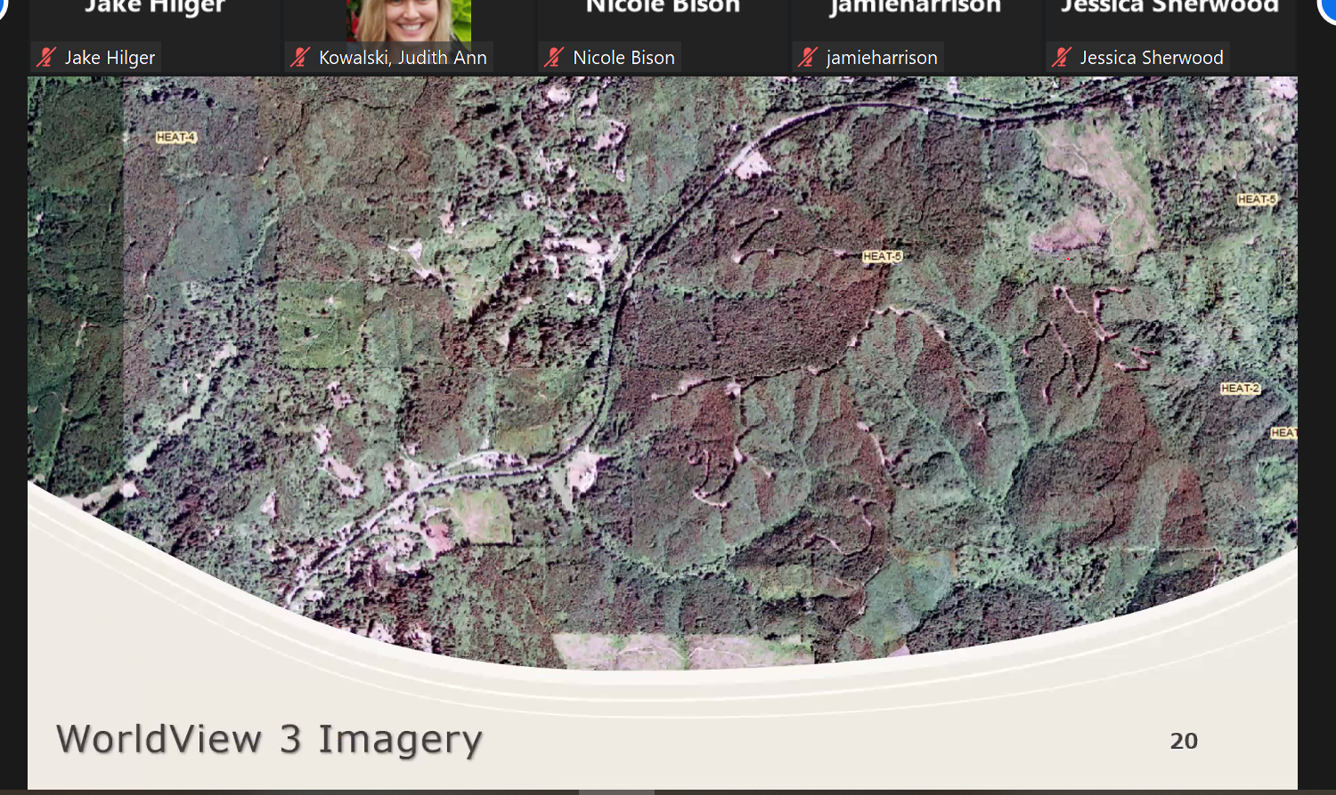
Aerial survey didn’t capture all areas – found imagery wordlivew 3
Clearly see damage

Slide 41
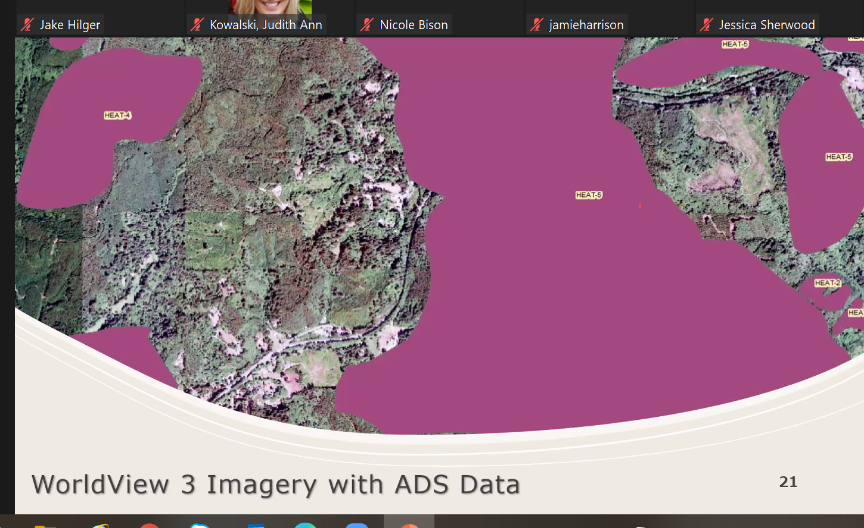
Unable to capture large amounts of data

Slide 42
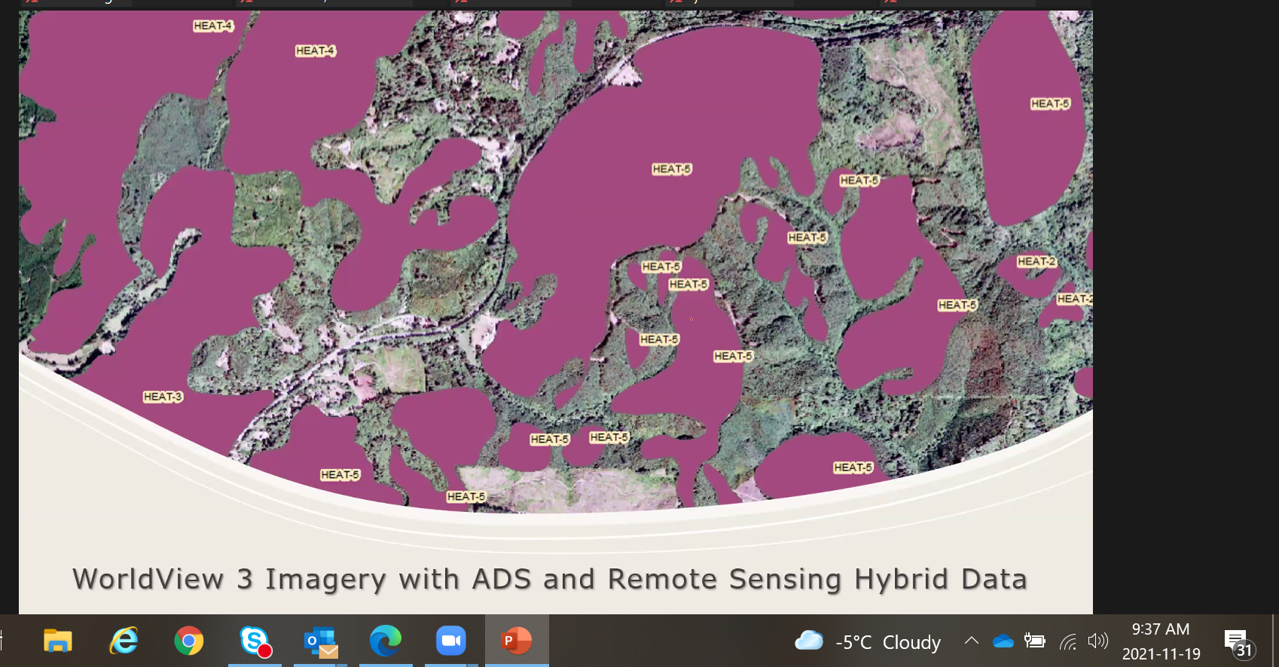

Slide 43
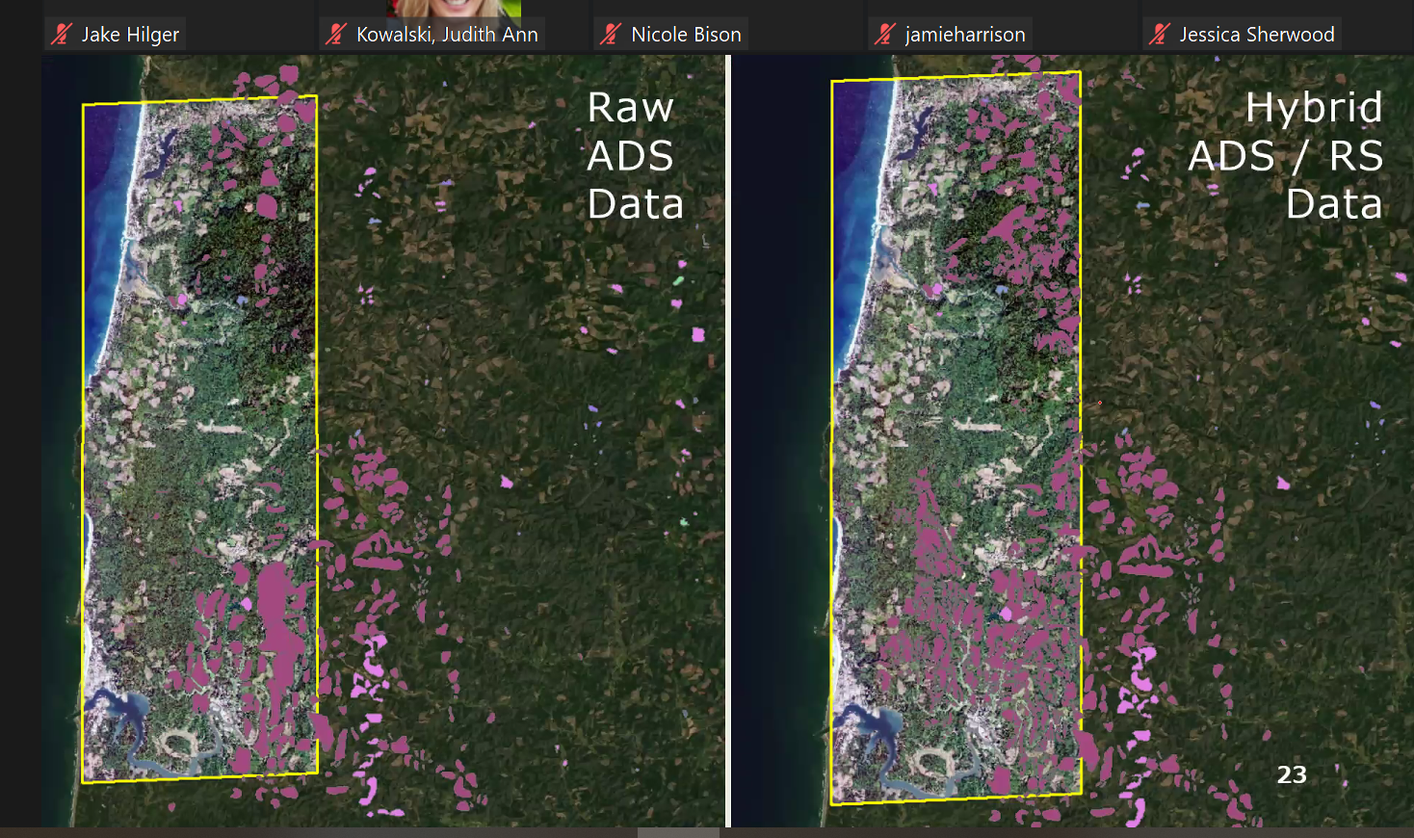

Slide 44
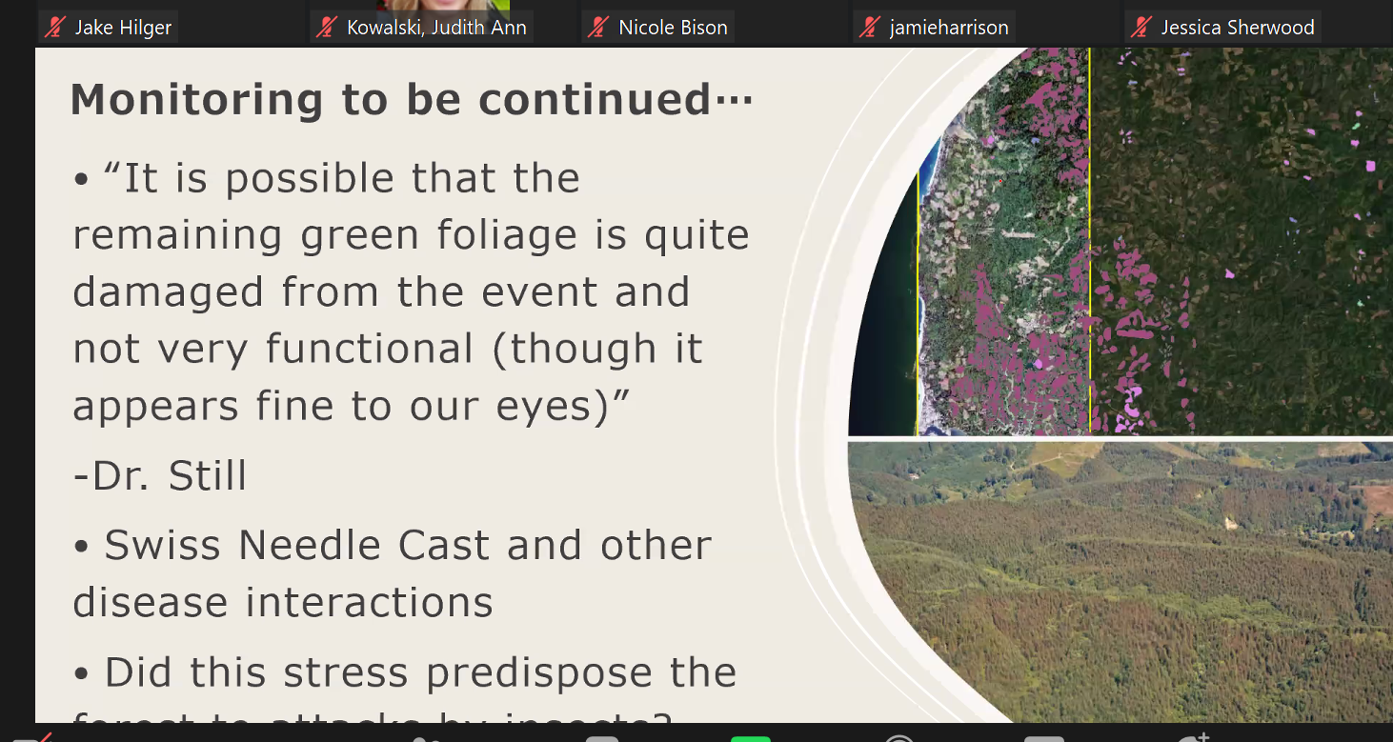

Slide 45
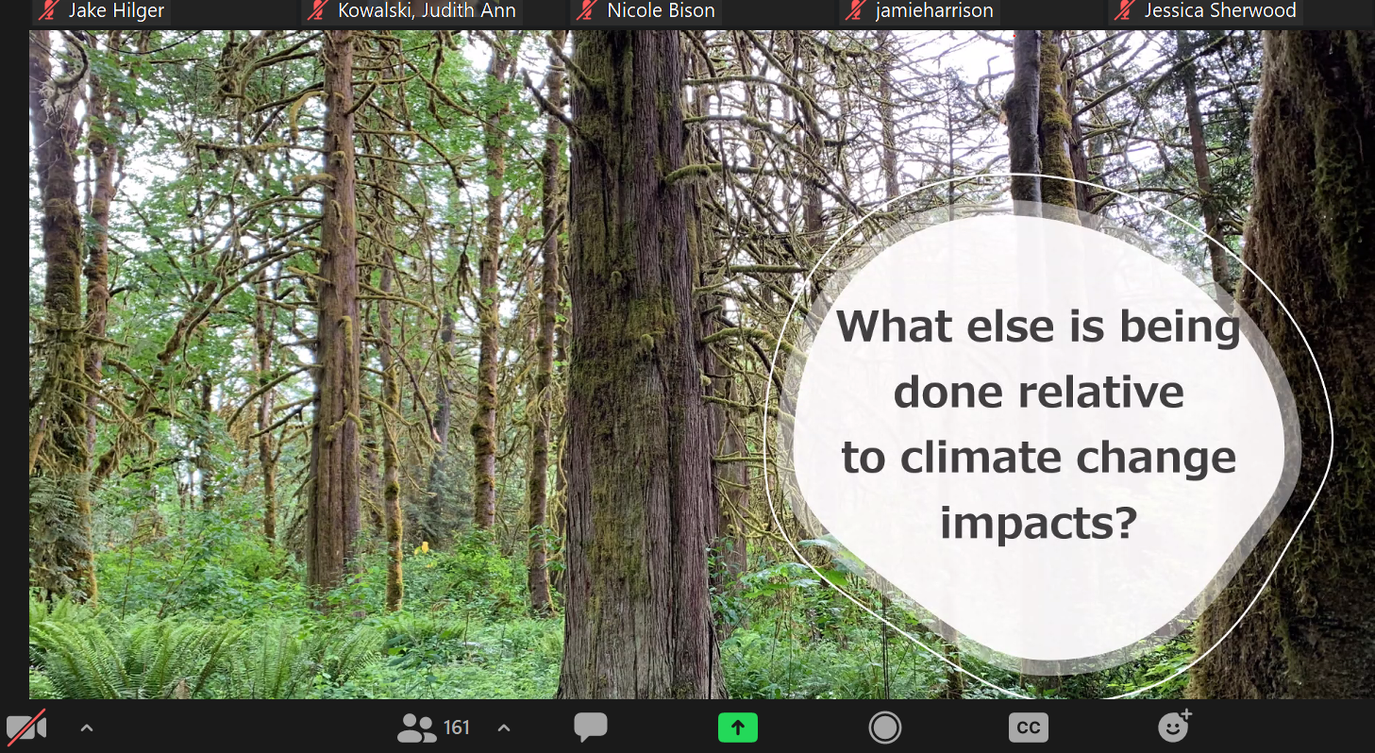

Slide 46
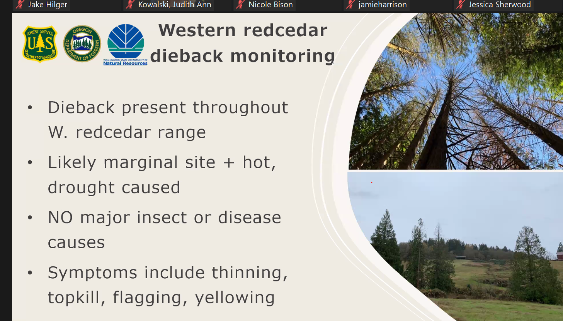
Western red cedar dieback – project with Sara Nevaro

Slide 47
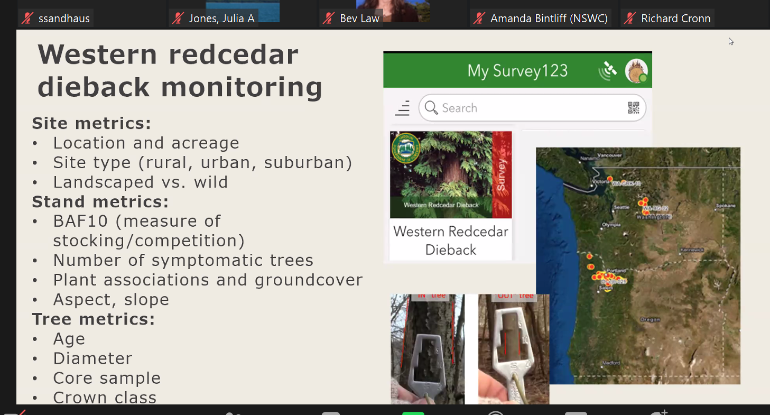

Slide 48
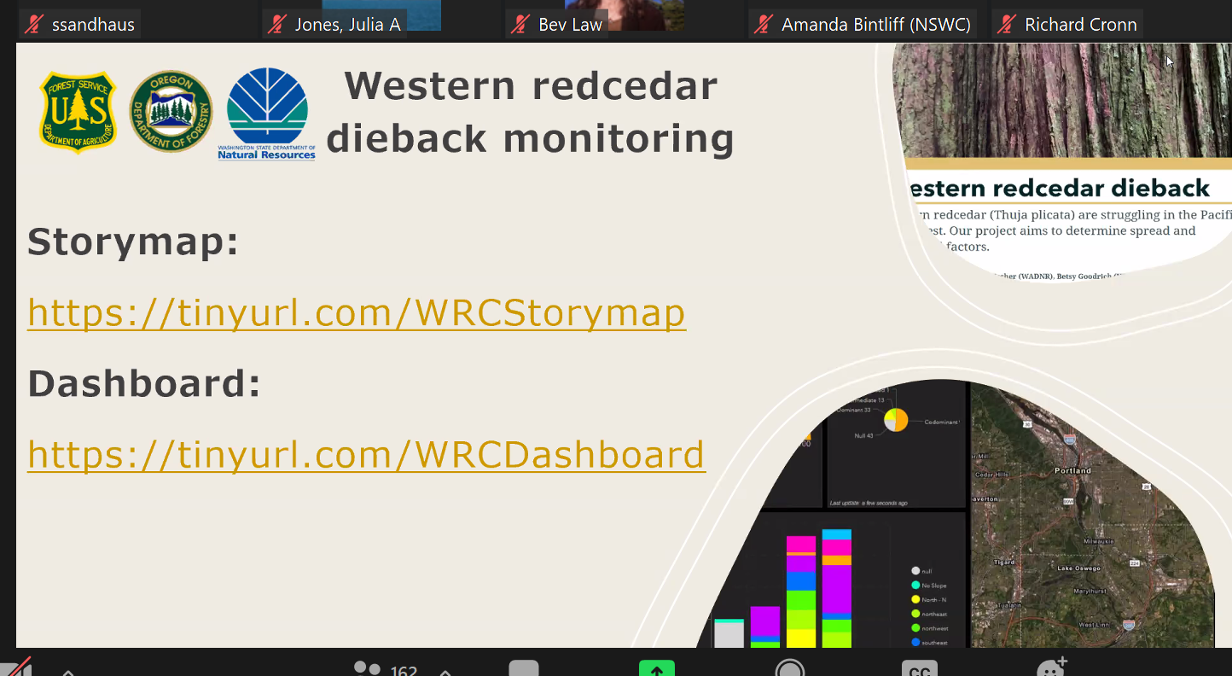

Slide 49
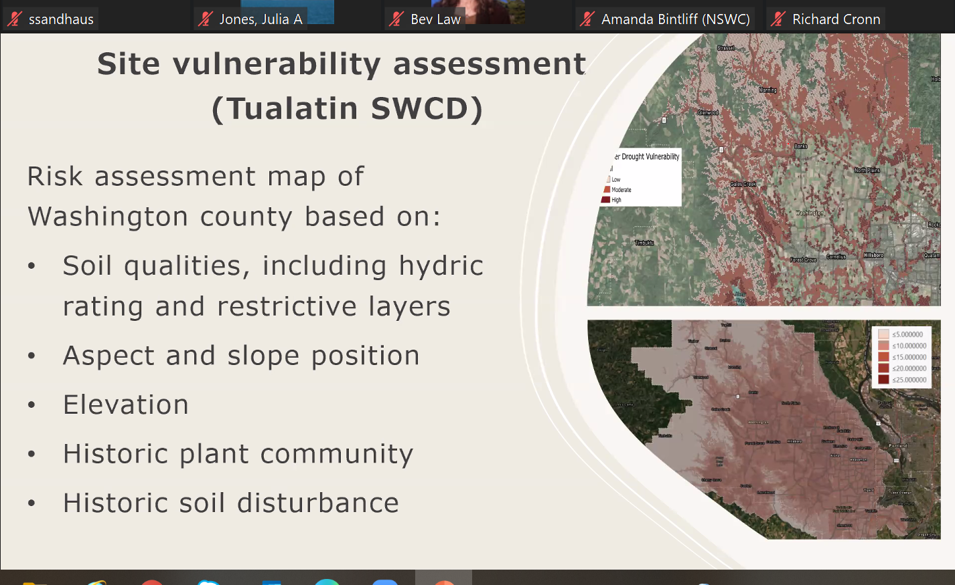

Slide 50
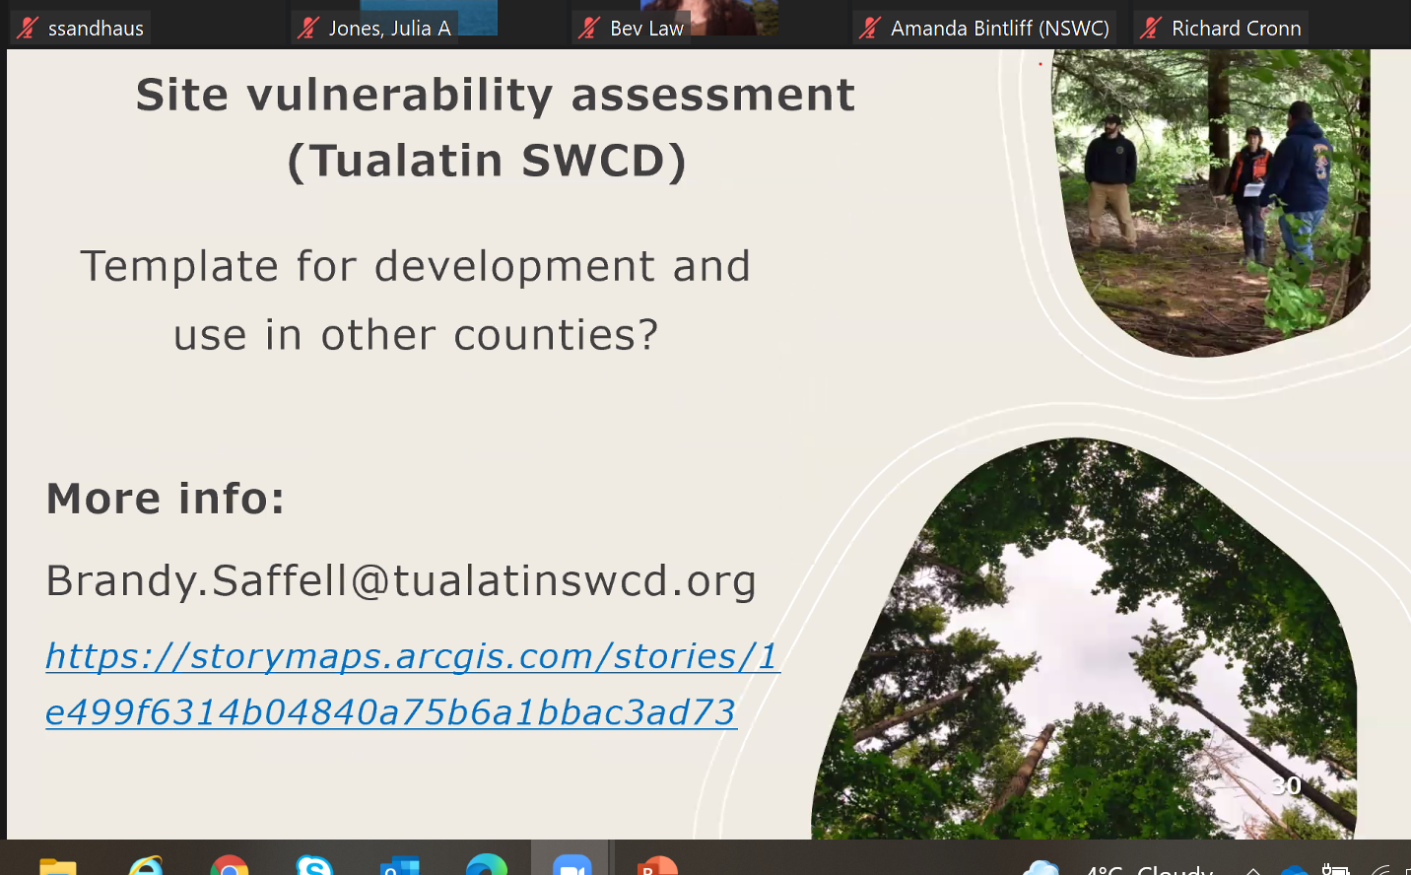

Slide 51
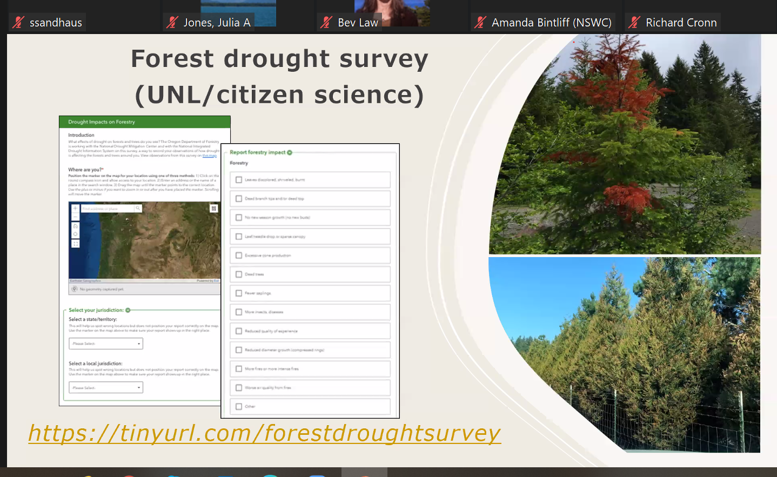
U Lincoln Nebraska forest drought survey
Report landscape public and heat scotch and drought

Slide 52
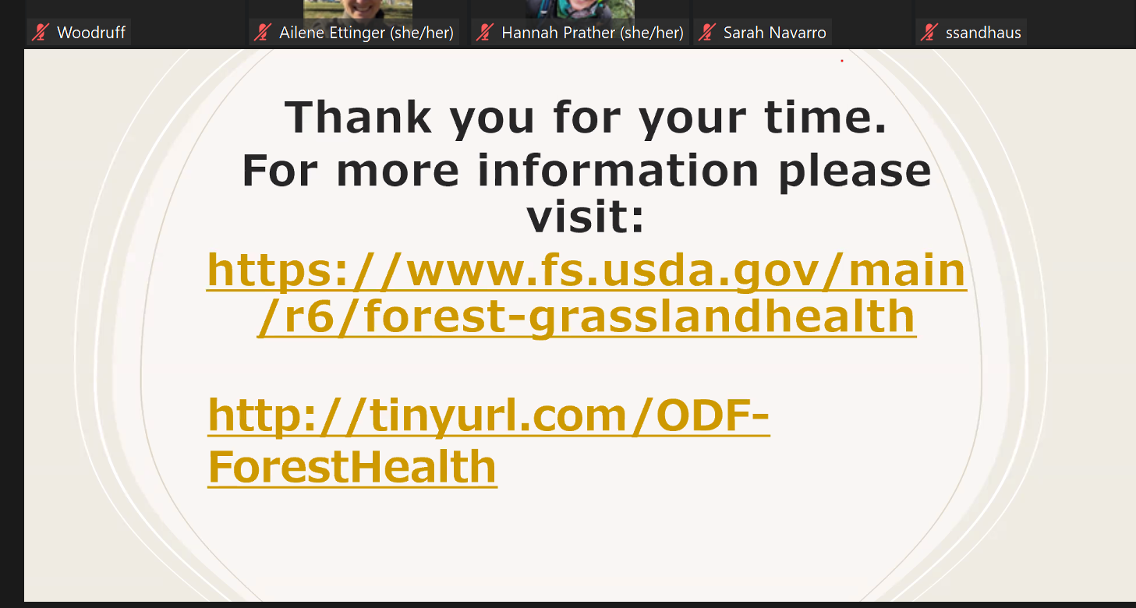

Slide 54
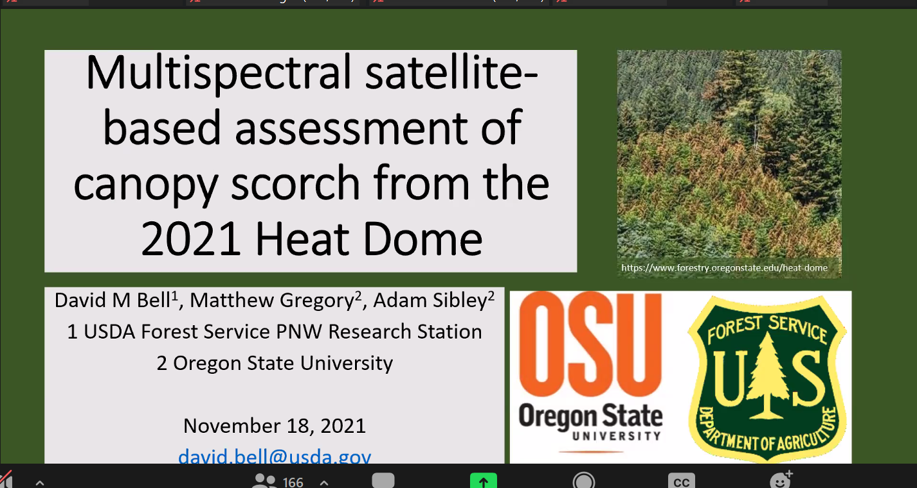

Slide 55
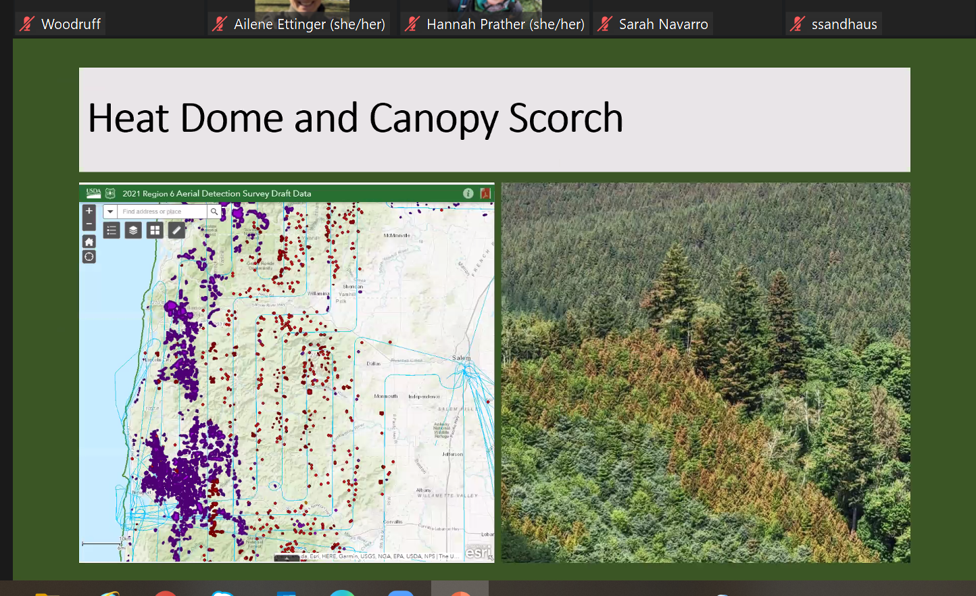

Slide 56
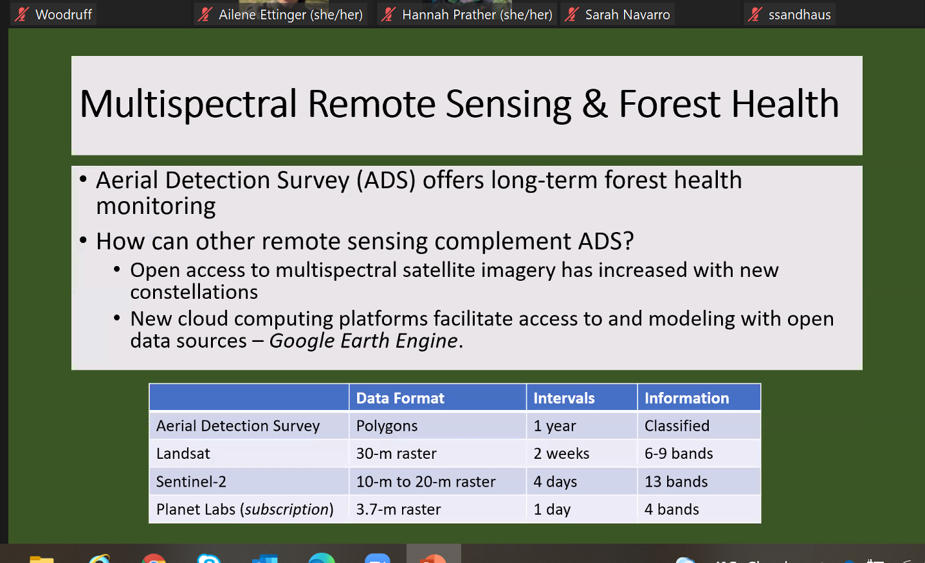

Slide 57
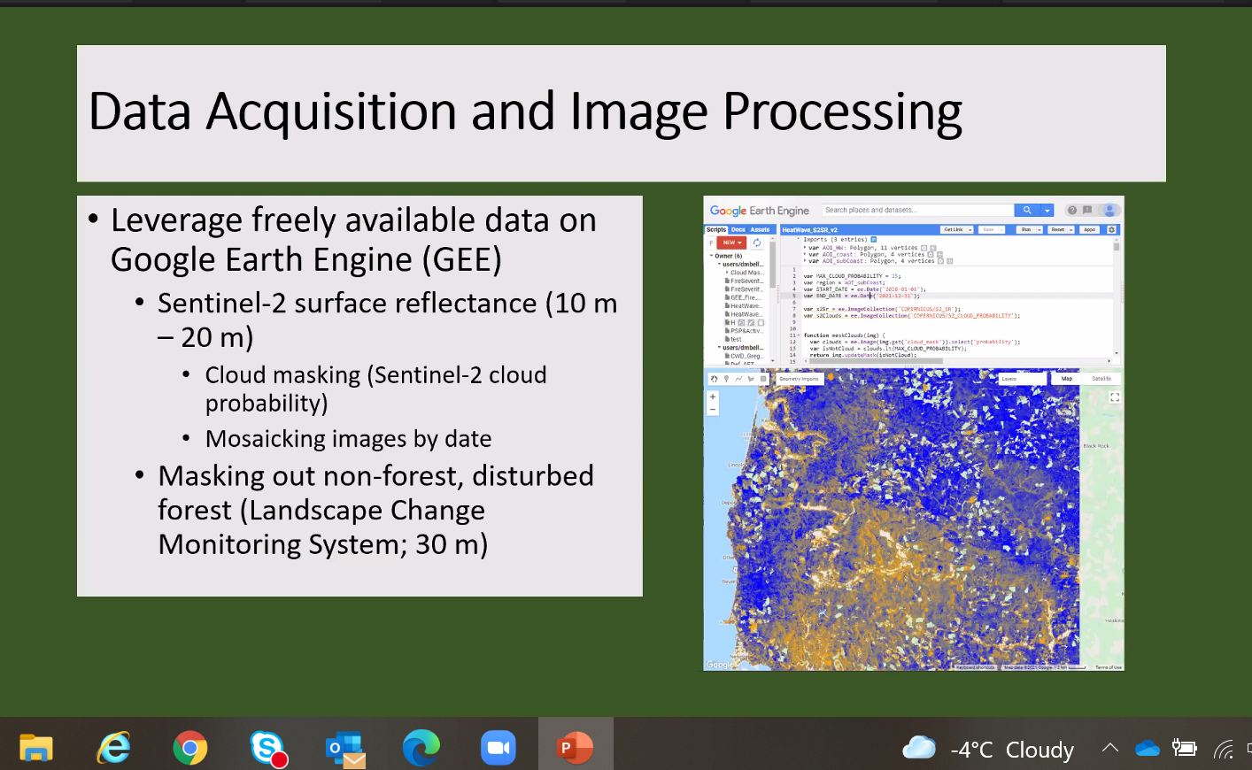

Slide 58

12 metrics
Disease water index (DSWI)
Red – does it look red to the eye
Senescence – loss of foliage

Slide 59

2 month window before and after heat dome
Red – negative trends DSWI
Overlay ADS polygons
Big patches of red inside and outside poulgyons

Slide 60

Blacks are negative patterns

Slide 61


Slide 63

Non heat related disturbance

Slide 64

Fine grain variability
Signals building what models used?
What landscape features ass. With disturbances

Slide 65


